Slide 1
FORM VALIDATION

Slide 2
Form validation
It is important to validate the form submitted by the user because it can have inappropriate values. So, validation is must to authenticate user.​
JavaScript provides facility to validate the form on the client-side so data processing will be faster than server-side validation. Most of the web developers prefer JavaScript form validation.​
Through JavaScript, we can validate name, password, email, date, mobile numbers and more fields.​
In this example, we are going to validate the name and password. The name can’t be empty and password can’t be less than 6 characters long.​
Here, we are validating the form on form submit. The user will not be forwarded to the next page until given values are correct.

Slide 3
Data Validation​
Data validation is the process of ensuring that user input is clean, correct, and useful.​
Typical validation tasks are:​
-has the user filled in all required fields?​
-has the user entered a valid date?​
-has the user entered text in a numeric field?​
Most often, the purpose of data validation is to ensure correct user input.​
Validation can be defined by many different methods, and deployed in many different ways.​
Server side validation is performed by a web server, after input has been sent to the server.​
Client side validation is performed by a web browser, before input is sent to a web server.​

Slide 4
Form Validation
<html>
<head>
<script>
function validate()
{
if(document.myform.Name.value=="")
alert("U have left name as blank")
}
</script>
</head>
<body>
<form name="myform" onsubmit="validate()">
<input type="text" name="Name">
<input type="submit" value="Submit">
</form>
</body>
</html>

Slide 5
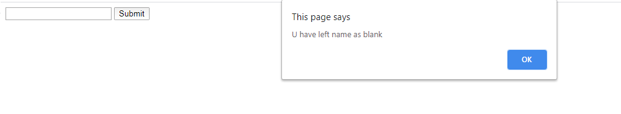
Output:

Slide 6
Form Validation
<html>
<head>
<script>
function validate()
{
var emailID = document.myform.email.value;
atpos = emailID.indexOf("@");
dotpos = emailID.lastIndexOf(".");
if (atpos < 1 || ( (dotpos - atpos) < 2 )) {
alert("Please enter correct email ID")
}
}
</script>
</head>
<body>
<form name="myform" onsubmit="validate()">
<input type="text" name="email">
<input type="submit" value="Submit">
</form>
</body>
</html>

Slide 7
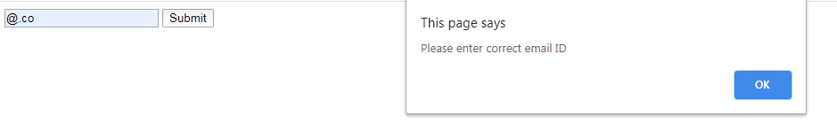

Slide 8
<html>
<body>
<h2>JavaScript Can Validate Input</h2>
<p>Please input a number between 1 and 10:</p>
<input id="numb">
<button type="button" onclick="myFunction()">Submit</button>
<p id="demo">Result</p>
<script>
function myFunction() {
var x, text;
// Get the value of the input field with id="numb"
x = document.getElementById("numb").value;
// If x is Not a Number or less than one or greater than 10
if (isNaN(x) || x < 1 || x > 10) {
text = "Input not valid";
} else {
text = "Input OK";
}
document.getElementById("demo").innerHTML = text;
}
</script></body></html>

Slide 9
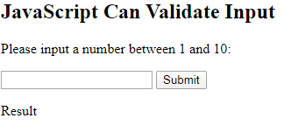
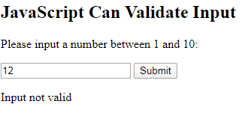
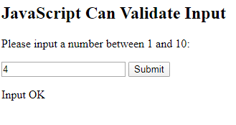
Output

Slide 10
HTML Constraint Validation​
HTML5 introduced a new HTML validation concept called constraint validation.​
HTML constraint validation is based on:​
-Constraint validation HTML Input Attributes​
-Constraint validation CSS Pseudo Selectors​
-Constraint validation DOM Properties and Methods​

Slide 11
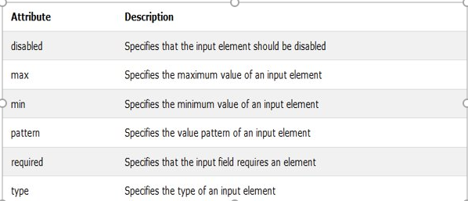
Constraint Validation HTML Input Attributes​

Slide 12
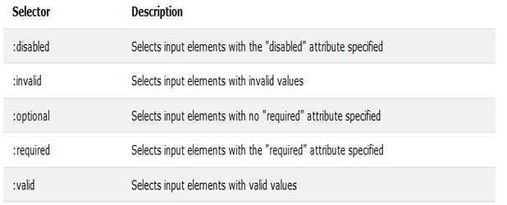
Constraint Validation CSS Pseudo Selectors​

Slide 13
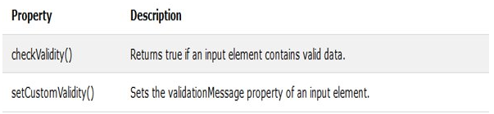
JavaScript Validation API​
Constraint Validation DOM Methods

Slide 14
checkValidity()
<html>
<body>
<p>Enter a number and click OK:</p>
<input id="id1" type="number" min="100" max="300" required>
<button onclick="myFunction()">OK</button>
<p>If the number is less than 100 or greater than 300, an error message will be displayed.</p>
<p id="demo"></p>
<script>
function myFunction() {
var inpObj = document.getElementById("id1");
if (!inpObj.checkValidity()) {
document.getElementById("demo").innerHTML = inpObj.validationMessage;
} else {
document.getElementById("demo").innerHTML = "Input OK";
}
}
</script></body></html>

Slide 15
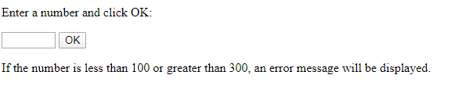
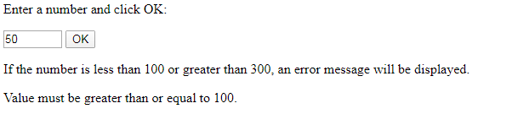
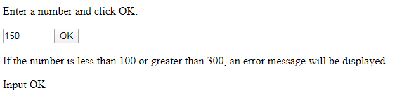
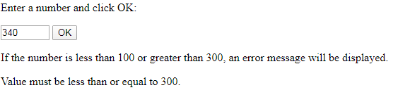
Output

Slide 16
Constraint Validation DOM Properties
Property | Description
validity | Contains boolean properties related to the validity of an input element.
validationMessage | Contains the message a browser will display when the validity is false.
willValidate | Indicates if an input element will be validated.

Slide 17
Validity Properties
The validity property of an input element contains a number of properties related to the validity of data:

Slide 18
Property | Description
customError | Set to true, if a custom validity message is set.
patternMismatch | Set to true, if an element's value does not match its pattern attribute.
rangeOverflow | Set to true, if an element's value is greater than its max attribute.
rangeUnderflow | Set to true, if an element's value is less than its min attribute.
stepMismatch | Set to true, if an element's value is invalid per its step attribute.
tooLong | Set to true, if an element's value exceeds its maxLength attribute.
typeMismatch | Set to true, if an element's value is invalid per its type attribute.
valueMissing | Set to true, if an element (with a required attribute) has no value.
valid | Set to true, if an element's value is valid.

Slide 19
rangeOverflow
<html>
<body>
<p>Enter a number and click OK:</p>
<input id="id1" type="number" max="100">
<button onclick="myFunction()">OK</button>
<p>If the number is greater than 100 (the input's max attribute), an error message will be displayed.</p>
<p id="demo"></p>
<script>
function myFunction() {
var txt = "";
if (document.getElementById("id1").validity.rangeOverflow) {
txt = "Value too large";
} else {
txt = "Input OK";
}
document.getElementById("demo").innerHTML = txt;
}
</script> </body></html>

Slide 20
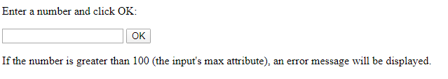
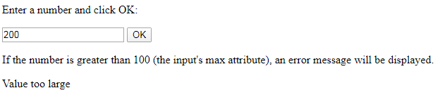
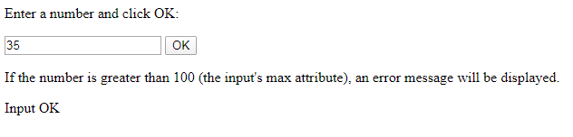
Output

Slide 21
rangeUnderflow
<html>
<body>
<p>Enter a number and click OK:</p>
<input id="id1" type="number" min="100">
<button onclick="myFunction()">OK</button>
<p>If the number is less than 100 (the input's min attribute), an error message will be displayed.</p>
<p id="demo"></p>
<script>
function myFunction() {
var txt = "";
if (document.getElementById("id1").validity.rangeUnderflow) {
txt = "Value too small";
} else {
txt = "Input OK";
}
document.getElementById("demo").innerHTML = txt;
}
</script>
</body>
</html>

Slide 22
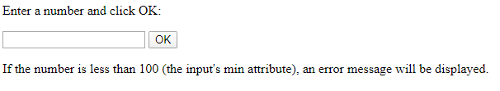
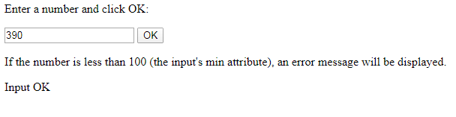
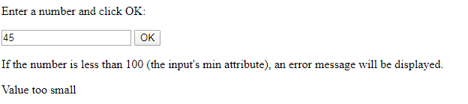
Output

Slide 23
THANK YOU

